Slide 1

DIGITAL THINKING AND INNOVATION CT109-3-1-DGTIN
ISSUED BY : ASIA PACIFIC UNIVERSITY OF TECHNOLOGY AND INNOVATION

Slide 2
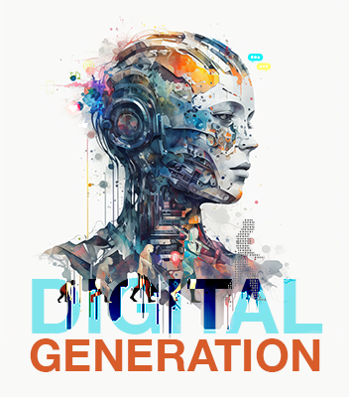
UNIT 1 DIGITAL GENERATION
.

Slide 3
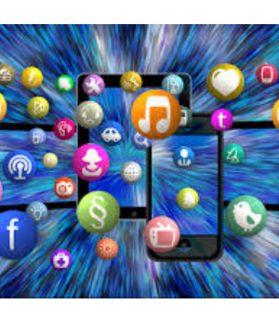
INTRODUCTION
This topic introduces the digital generation: the era of the digital natives.

Slide 4

At the end of this lecture you will be able to:
Understand the Digital Generation
Differentiate between the Millennials and the Gen Z
Highlight the characteristics of Gen Z
Discuss how Gen Z will shape the future

Slide 5

CONTENT
Digital Generation
The Generation Z
Characteristics
Video : Generation Z: The Social Demise of the Digital Natives

Slide 6
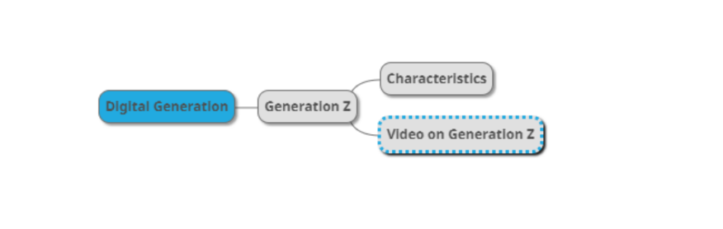
MIND MAP

Slide 7
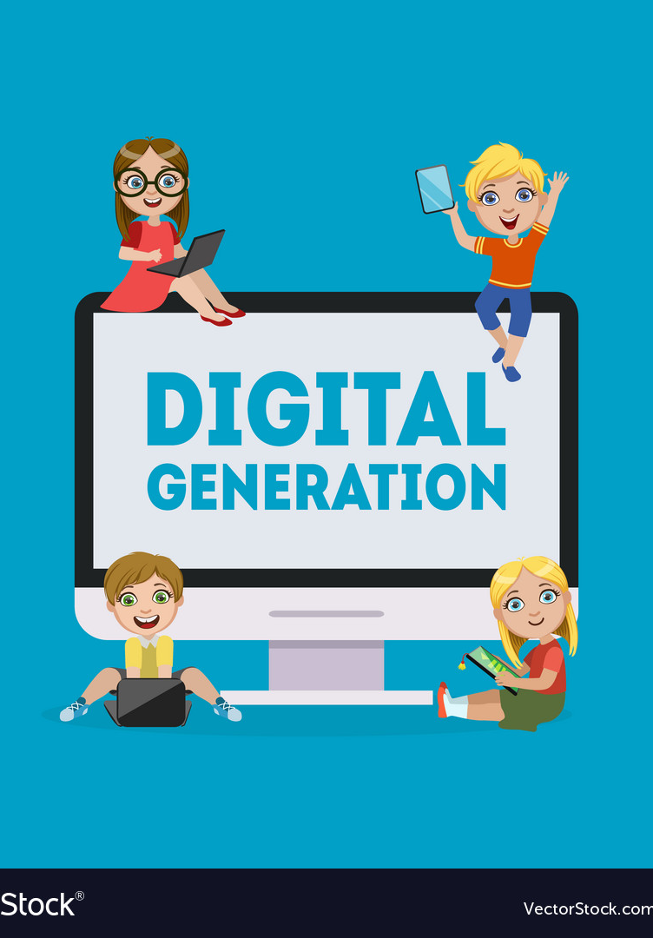
DIGITAL GENERATION
Digital Generation: Generation Z or Gen Z(1997 to 2012), also known as zoomers, is the demographic cohort succeeding Millennials and preceding Generation Alpha.
Those who are growing up constantly connected to the world around them through smartphones, tablets, and computers.
Because of this hyper connectivity, this generation will learn, think, act and respond differently than the previous generations.
This generation is also called “digital natives” because they have been immersed in digital environments from a young age and are highly comfortable using technology for communication, entertainment, and education.
Research: copy on the link below to understand the different generations (Boomers, Gen X, Gen Y, and Gen Z )
https://offer.kasasa.com/exchange/articles/generations/gen-x-gen-y-gen-z

Slide 8
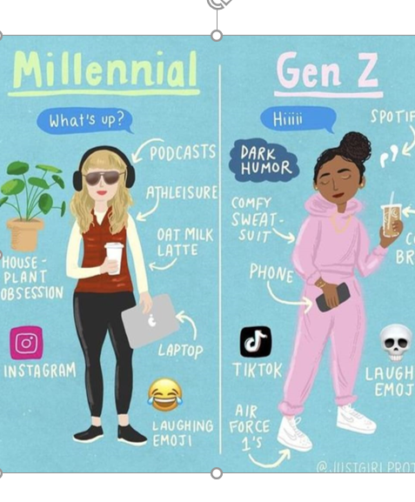
Comparison :The Millennials Vs Gen Z
SIMILARITY
On the surface, Gen Z may seem similar to Millennials
Both
i) are shaped by technology
ii) Have mostly lived life in a mobile-first world
DIFFERENCES
Markedly different in how they:
i) Shop
ii) Interact with brands
iii) View money

Slide 9
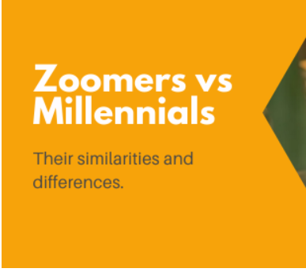
SIMILARITY
1) Shaped by Technology: Millennials and Gen Z have been heavily influenced by digital technology, shaping their lifestyle, communication styles, and preferences.
Due to their technological upbringing, both generations are adept at using digital tools and social media for communication, learning, and entertainment. They quickly adapt to new technology and are comfortable in online spaces.
2)Mobile-First World: Both generations are accustomed to a "mobile-first" lifestyle, where smartphones and mobile devices are central to their daily routines. Millennials saw the rise of mobile technology during their formative years, while Gen Z has grown up with mobile devices as their primary tool for accessing information and staying connected.

Slide 10
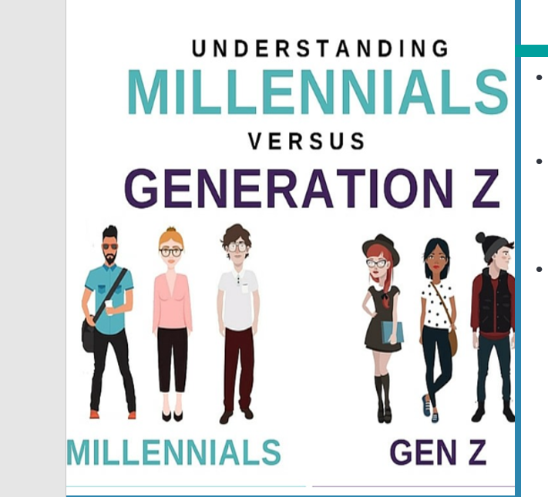
DIFFERENCES
1) Shopping Habits: Millennials often value convenience, brand loyalty, and established brands that have strong online presence whereas Gen Z is highly influenced by user-generated content and peer reviews on platforms like TikTok. Also, Interactive, personalized shopping experiences are important to Gen Z, and they expect direct brand engagement on social media.
2) Interaction with brands: Millennials often follow brands that reflect their interests or lifestyle and value community and tend to favor brands that foster a sense of belonging. Gen Z, however, interacts with brands more directly on platforms like TikTok, where trends and peer-driven content have significant influence often preferring those that embrace humor.
3) View of Money: Many Millennials face financial challenges due to student loans and high living costs, but they still prioritize spending on experiences and convenience, often using credit cards and payment plans whereas GenZ are interested in financial literacy, often beginning to invest early. Gen Z tends to be more wary of debt and is more likely to use financial apps and budgeting tools to manage their finances.

Slide 11
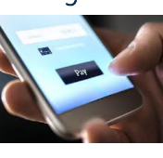
Gen Z: A “throwback generation”
“One that wants to work, save money, and not get stuck or trapped by credit”. (The Center for Generational Kinetics, State of Gen Z 2017 Study)
48% of Gen Z has a money or payment app on their phone right now.
More ad-averse:
More willing compare other generations to engage with brands
Doesn’t find brand texts, notifications or mobile offers invasive
Spends more than an hour a day on their mobile device
Many are already thinking about retirement
Personal debt should be avoided at all costs
A marked shift from the Millennial mindset that “college debt is a part of life”

Slide 12
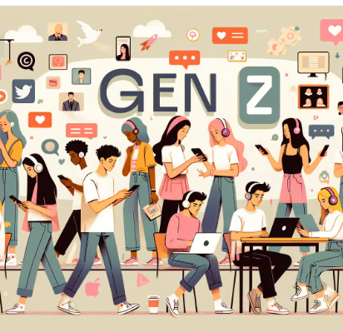
Characteristics
Insightful & Savvy
Responsible Self-Starters
Risk-Averse & Adaptable
Tech-Enabled

Slide 13
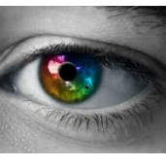
Insightful & Savvy
Information and “world knowledge” are vastly available
They know what they know, and they know what they don’t know
They can see through the disingenuous motives of traditional marketing
They want to be served in a transparent and socially responsible way

Slide 14
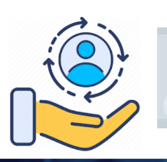
Responsible Self-Starters
Driven, hard-working, and generally responsible
Clever and industrious — eager to put in the hard work to fulfill their dreams
Believe technology can be their catalyst
Generally understand the concept of making money work for them, both immediately today and down the road tomorrow
Want to help create jobs and contribute to a thriving, balanced global economy

Slide 15

Risk-Averse & Adaptable
Understand that everything can change in a minute
A sense of extreme pragmatism
Gen Z consumers cautiously weigh the practicality of their material purchases
Many have a savings-conscious mindset
Critically consider the value equation of any purchase
See technology advancing day by day, and know that something that exists today could be improved tomorrow

Slide 16

Tech-Enabled
Access to computers and smartphones at a very early age
“Digital Natives”, but still crave and value human contact
Have the adaptability to learn faster, and have a self-starter mentality that empowers them to figure things out on their own

Slide 17

Stereotype Negative Traits?
Have a short attention span (eight seconds)
Able to communicate effectively and concisely
Multitaskers – increases stress level
Can thrive in a “chaotic” environment, increase productivity, save money, and time.
Addicted to technology and can’t handle face-to-face interactions
Willing to be technology mentors to others in the office
Expect too much from the brands and companies they interact with
Have strong beliefs (ethically)
Tend to job-hop and ghost employers
Employers will have to rise to the challenge
Competitive benefits
Great company culture
Opportunities for career growth

Slide 18

Group Discussion
Watch and discuss the content of the video:
TOPIC: Generation Z: The Social Demise of the Digital Natives
link:
https://www.youtube.com/watch?v=a7ff98PL2X4

Slide 19

Next Lecture
Agile and Digital Thinking

